Slide 1

E-Commerce Order Fulfilment Data Platform
End-to-End Data Engineering Pipeline using Python, SQLite, Apache Airflow and Power BI
Presented By:
SHASHIKANTH
Post Graduate Program in Data Science
(Data Engineering)
Hero Vired

Slide 2
AGENDA
Business Problem
Technology Stack
ETL Architecture
Airflow
Dashboard
Objectives
Dataset
Conclusion
Bronz layer
Silver layer
Gold layer
SQLite
Insights

Slide 3
BUSINESS PROBLEM
🗂️ Multiple CSV Files
📊 Manual Reporting
📦 Order Tracking Challenges
🚚 Delivery Monitoring
😊 Customer Satisfaction Analysis
Goal: Build an automated ETL pipeline to transform raw e-commerce data into analytics-ready insights.

Slide 4
📥 |  | Data Ingestion
🧹 |  | Data Cleaning
🏗️ |  | Gold Layer Creation
⚙️ |  | Airflow Automation
🗄️ |  | SQLite Storage
📈 |  | Power BI Dashboard
OBJECTIVES

Slide 5
📂 Dataset Overview
Source: Olist Brazilian E-Commerce Dataset
📦 Orders 👤 Customers 🛍 Products
99,441 99,441 32,951
💳 Payments ⭐ Reviews 🏪 Sellers
103,886 99,224 3,095
📁 Tables Used:
•Orders
• Customers
• Products
•Payments
• Reviews
• Sellers
• Order Items

Slide 6
Tools and Technologies Used Throughout the ETL Pipeline
TECHNOLOGY STACK
🐍 Python - ETL Development
↓
🐼 Pandas - Data Cleaning & Transformation
↓
🗄️ SQLite - Data Storage
↓
🌬️ Apache Airflow - Workflow Orchestration
↓
📊 Power BI - Dashboard & Analytics
↓
🐙 GitHub - Version Control

Slide 7
Project Architecture
📂Raw CSV Data
│
▼
🟫 Bronze Layer
│
▼
🧹Silver Layer
│
▼
🥇Gold Layer
│
▼
🗄️ SQLite DB
│
▼
🌬️Apache Airflow
│
▼
📊Power BI Dashboard

Slide 8
BRONZE LAYER
Raw Data Ingestion & Storage Layer
📂
Raw CSV Files
(Orders, Customers, Products, 🗄️ Bronze Layer
Payments, Reviews, Items, Seller)
🎯 Purpose ⚙️ Key Activities
📦 Store Raw Data 📥 Raw CSV Ingestion
🔒 Preserve Original Data 📂 Historical Storage
📝 No Data Modification ✅ Source Integrity

Slide 9
SILVER LAYER
(Data Cleaning, Transformation & Validation)
🗄️ Bronze Layer 🧹 Cleaning Process 🩶 Silver Layer
🎯 Purpose ⚙️ Key Activities
🧹 Clean Data ❌ Remove Duplicates
✔️ Improve Quality 🔄 Convert Timestamps
📊 Standardize Data 🚫 Handle Missing Values
🛡️ Validate Records ✅ Data Validation
💡 Clean, validated and standardized datasets are prepared for creating Gold Layer
analytical tables.

Slide 10
GOLD LAYER
(Analytics-Ready Data Warehouse)
🩶 Silver Layer
│
▼
🥇 Gold Layer
│
┌─────────────┴─────────────┐
▼ ▼
📊 Fact Tables 📋 Dimension Tables
Orders Customer
Payments Product
Reviews Seller
Delivery SLA
🎯 Purpose
📈 Business Analytics
📊 KPI Reporting
📉 Performance Analysis
📋 Dashboard Creation
⚙️ Output
⭐ Star Schema
🗄️ SQLite Database Tables
📊 Power BI Ready
⚡ Optimized for Fast Queries

Slide 11
DATA QUALITY
(Ensuring Data Accuracy, Consistency, and Reliability)
📋 Validation Checks
✅ Validation Rule | 📈 Result
Duplicate Order IDs | Passed
Missing Values Handling | Completed
Timestamp Format Validation | Passed
Negative Payment Values | Passed
Negative Freight Values | Passed
Data Type Standardization | Completed
💡 Key Outcome
All validation checks were successfully completed, producing clean, consistent, and analytics-ready data for the Gold Layer and Power BI Dashboard.

Slide 12
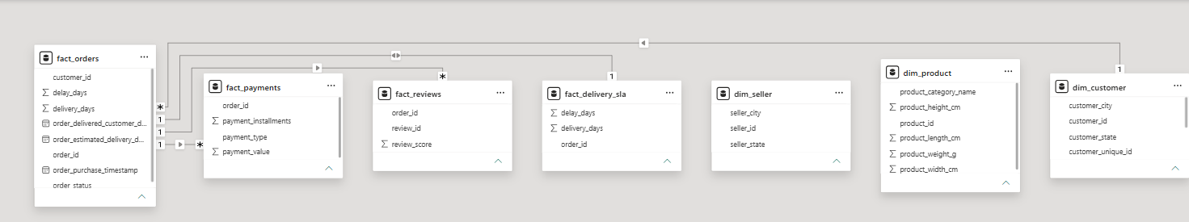
STAR SCHEMA
👤 Customer
🏪 Seller ─── 📦 Fact Orders ─── 📦 Product
┌────────────┼────────────┐
💳 Payments ⭐ Reviews 🚚 Delivery SLA

Slide 13
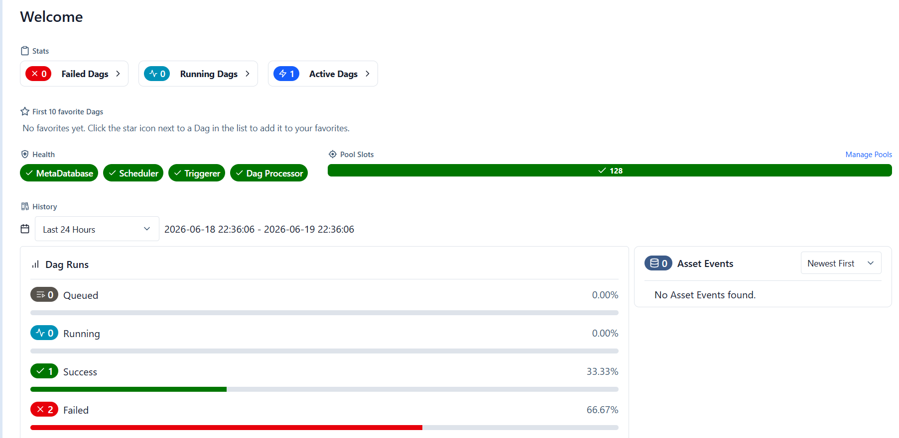
APACHE AIRFLOW
(Automating the ETL Pipeline Workflow)
⚙️ Key Features
• Workflow Automation
• DAG Scheduling
• Task Monitoring
• Logging & Retry
💡 Airflow automates the execution of the ETL pipeline, ensuring reliable scheduling, monitoring, and logging.

Slide 14
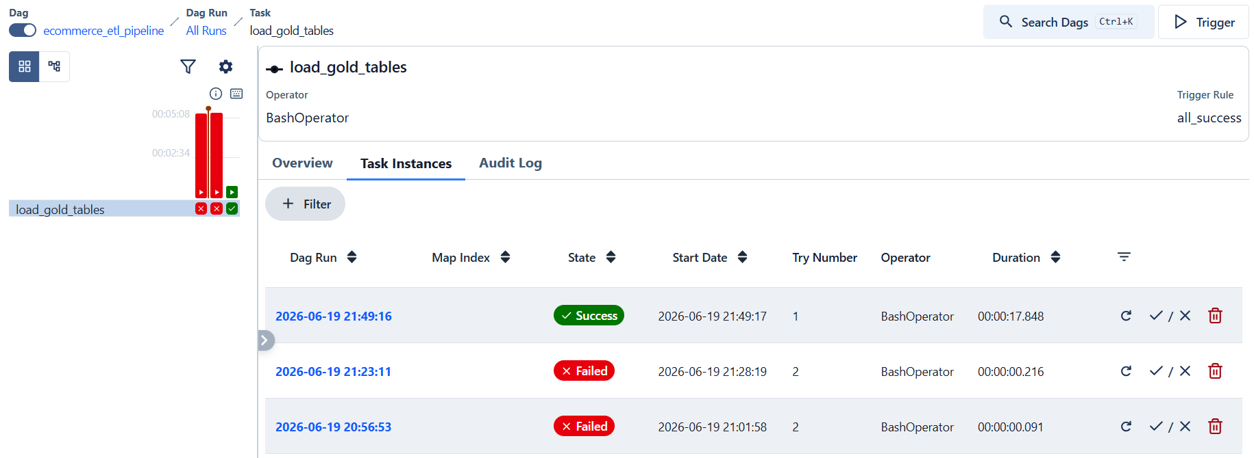
DAG EXECUTION
ETL Pipeline Execution
Workflow Steps
① DAG Triggered
② Read Gold Layer CSV Files
③ Execute load_to_sqlite.py
④ Load Data into SQLite
⑤ Task Completed Successfully
The Airflow DAG successfully executed the ETL workflow by loading the Gold Layer datasets into the SQLite database with execution monitoring and task status tracking.

Slide 15
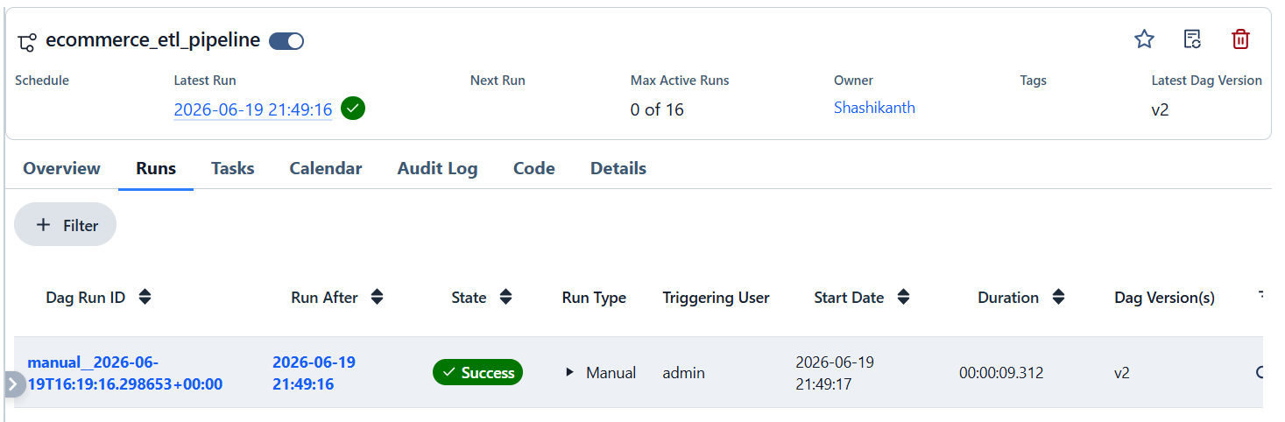
ETL PIPELINE SUCCESS
✅ ETL Pipeline Completed Successfully
📂 Gold Layer CSV Files
│
▼
🌬 Apache Airflow DAG
│
▼
🗄 SQLite Database
│
▼
📊 Power BI Dashboard
🟢 DAG Executed Successfully
🟢 Gold Layer Loaded
🟢 SQLite Database Updated
🟢 Dashboard Ready
The ETL pipeline completed successfully, transforming analytics-ready Gold Layer datasets into the SQLite database for business intelligence reporting through Power BI.

Slide 16
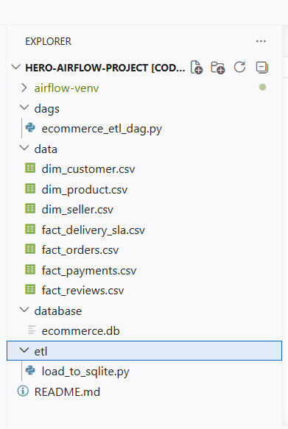
SQLITE DATABASE
(Centralized Storage for Gold Layer Tables)
📋 Database Features
• Lightweight Database
• Stores Gold Layer Tables
• Analytics Ready
• Source for Power BI
💡 SQLite stores the transformed Gold Layer tables,
providing a centralized data source for Power BI.

Slide 17
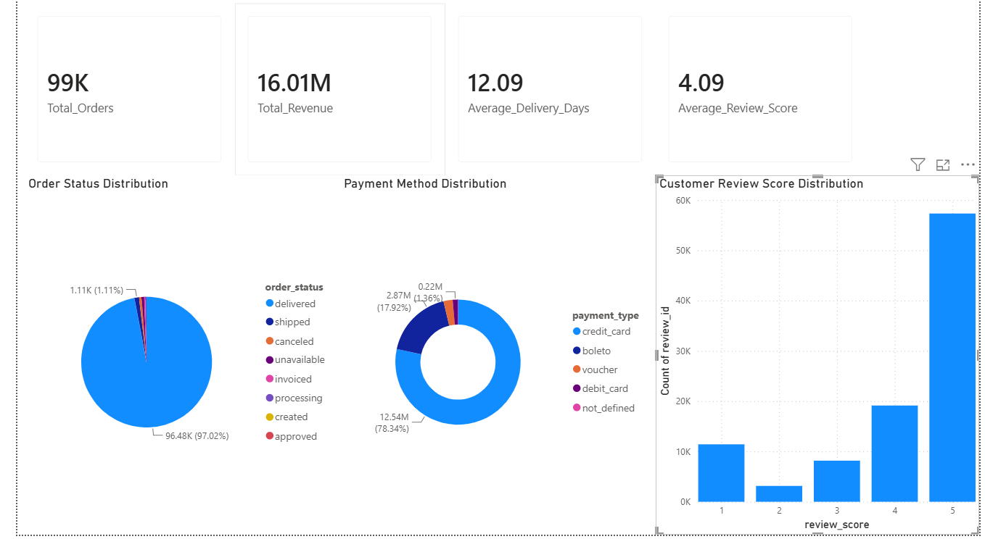
POWER BI DASHBOARD
(Interactive Business Intelligence & Performance Analytic)

Slide 18
BUSINESS INSIGHTS
(Key Findings from the Power BI Dashboard)
📦 Order Performance
99K+ Orders were successfully processed through the ETL pipeline, providing a comprehensive view of order fulfilment performance.
💰 Revenue Analysis
The platform generated approximately 16.01 Million in total revenue, indicating strong sales performance.
🚚 Delivery Performance
The average delivery time was 12.09 days, reflecting an efficient order fulfilment process.
⭐ Customer Satisfaction
The average customer review score was 4.09/5, showing a high level of customer satisfaction.
💳 Payment Insights
Credit Card was identified as the most preferred payment method among customers.
🎯 Business Value
The interactive dashboard enables stakeholders to monitor KPIs, evaluate operational performance, and make data-driven business decisions.

Slide 19
CHALLENGES & SOLUTIONS
(Challenges Encountered During ETL Pipeline Development)
🔹 Challenge 1
Multiple Raw Data Sources
Solution Integrated multiple CSV datasets into a unified ETL pipeline using Python and Pandas.
🔹 Challenge 2
Data Quality Issues
Solution Performed duplicate removal, timestamp conversion, missing value handling, and validation checks during the Silver Layer transformation.
🔹 Challenge 3
Workflow Automation
Solution Implemented Apache Airflow to automate ETL execution, scheduling, monitoring, and logging.
🔹 Challenge 4
Centralized Data Storage
Solution Stored analytics-ready Gold Layer tables in SQLite, creating a centralized repository for Power BI reporting.
💡 Key Achievement
Successfully developed an end-to-end automated Data Engineering pipeline that transforms raw e-commerce data into business-ready insights.

Slide 20
FUTURE SCOPE
(Potential Enhancements for the ETL Pipeline)
☁️ Cloud Deployment
Deploy the ETL pipeline on cloud platforms such as Microsoft Azure, AWS, or Google Cloud Platform for improved scalability.
⚡ Big Data Processing
Integrate Apache Spark to process large-scale datasets with better performance and distributed computing.
📡 Real-Time Data Processing
Implement real-time data ingestion and streaming using Apache Kafka or Apache Spark Streaming.
🤖 Predictive Analytics
Apply Machine Learning models to forecast sales, predict delivery delays, and analyze customer behavior.
🔄 Incremental Data Loading
Replace full data loads with incremental ETL processing to improve execution efficiency and reduce processing time.
🎯 Long-Term Vision
Develop a fully automated, cloud-based, real-time Data Engineering platform capable of supporting enterprise-scale analytics.

Slide 21
🎯 CONCLUSION
✅ KEY ACHIEVEMENTS
✔ End-to-End ETL Pipeline
✔ Medallion Architecture
✔ Apache Airflow Automation
✔ SQLite Data Storage
✔ Interactive Power BI Dashboard
💡 Final Takeaway
"Raw Data ➜ Business Insights"

Slide 22
THANK YOU

